Slide 1
Organizational intelligence technologies

Slide 2
Chapter Summary
Understand the centrality of digital databases to business intelligence (reading Chapter 13)
Discriminate between the data management challenges for
Storage/Capture versus
Reporting/Summarization
Explain the rationale behind the datawarehousing activities
Discriminate between different datawarehousing architectures
Develop a star and snowflake schemas to satisfy decision-making needs
Create a datawarehouse from transactional DB using SQL
Develop SQL queries to extract data from data warehouses for decision-making

Slide 3
Lessons & Chapter Problems
Business intelligence
1,2
Data warehousing activities
3,4
Business intelligence using a d/w
5,6
Data model for a D/w – Star Schema
8,9
Data model for D/w – Snowflake schema
SQL commands for D/W
RDMS vs MDDB
Data mining

Slide 4
Organizational intelligence
Lesson 1
Organizational intelligence is the outcome of an organization’s efforts to collect store, process, and interpret data from internal and external sources
Intelligence in the sense of gathering and distributing information

Slide 5
Types of information systems
Type of information system | System’s purpose
Transaction processing system TPS | Collects and stores data from routine transactions
Management information system MIS | Converts data from a TPS into information for planning, controlling, and managing an organization
Decision support system DSS | Supports managerial decision making by providing models for processing and analyzing data
Business Intelligence BI | Enables the business to develop a better understanding of its key stakeholders and organizational environment
On-line analytical processing OLAP | Presents a multidimensional, logical view of data to the analyst with no requirements as to how the data are stored
Data mining | Uses statistical analysis and artificial intelligence techniques to identify hidden relationships in data

Slide 6
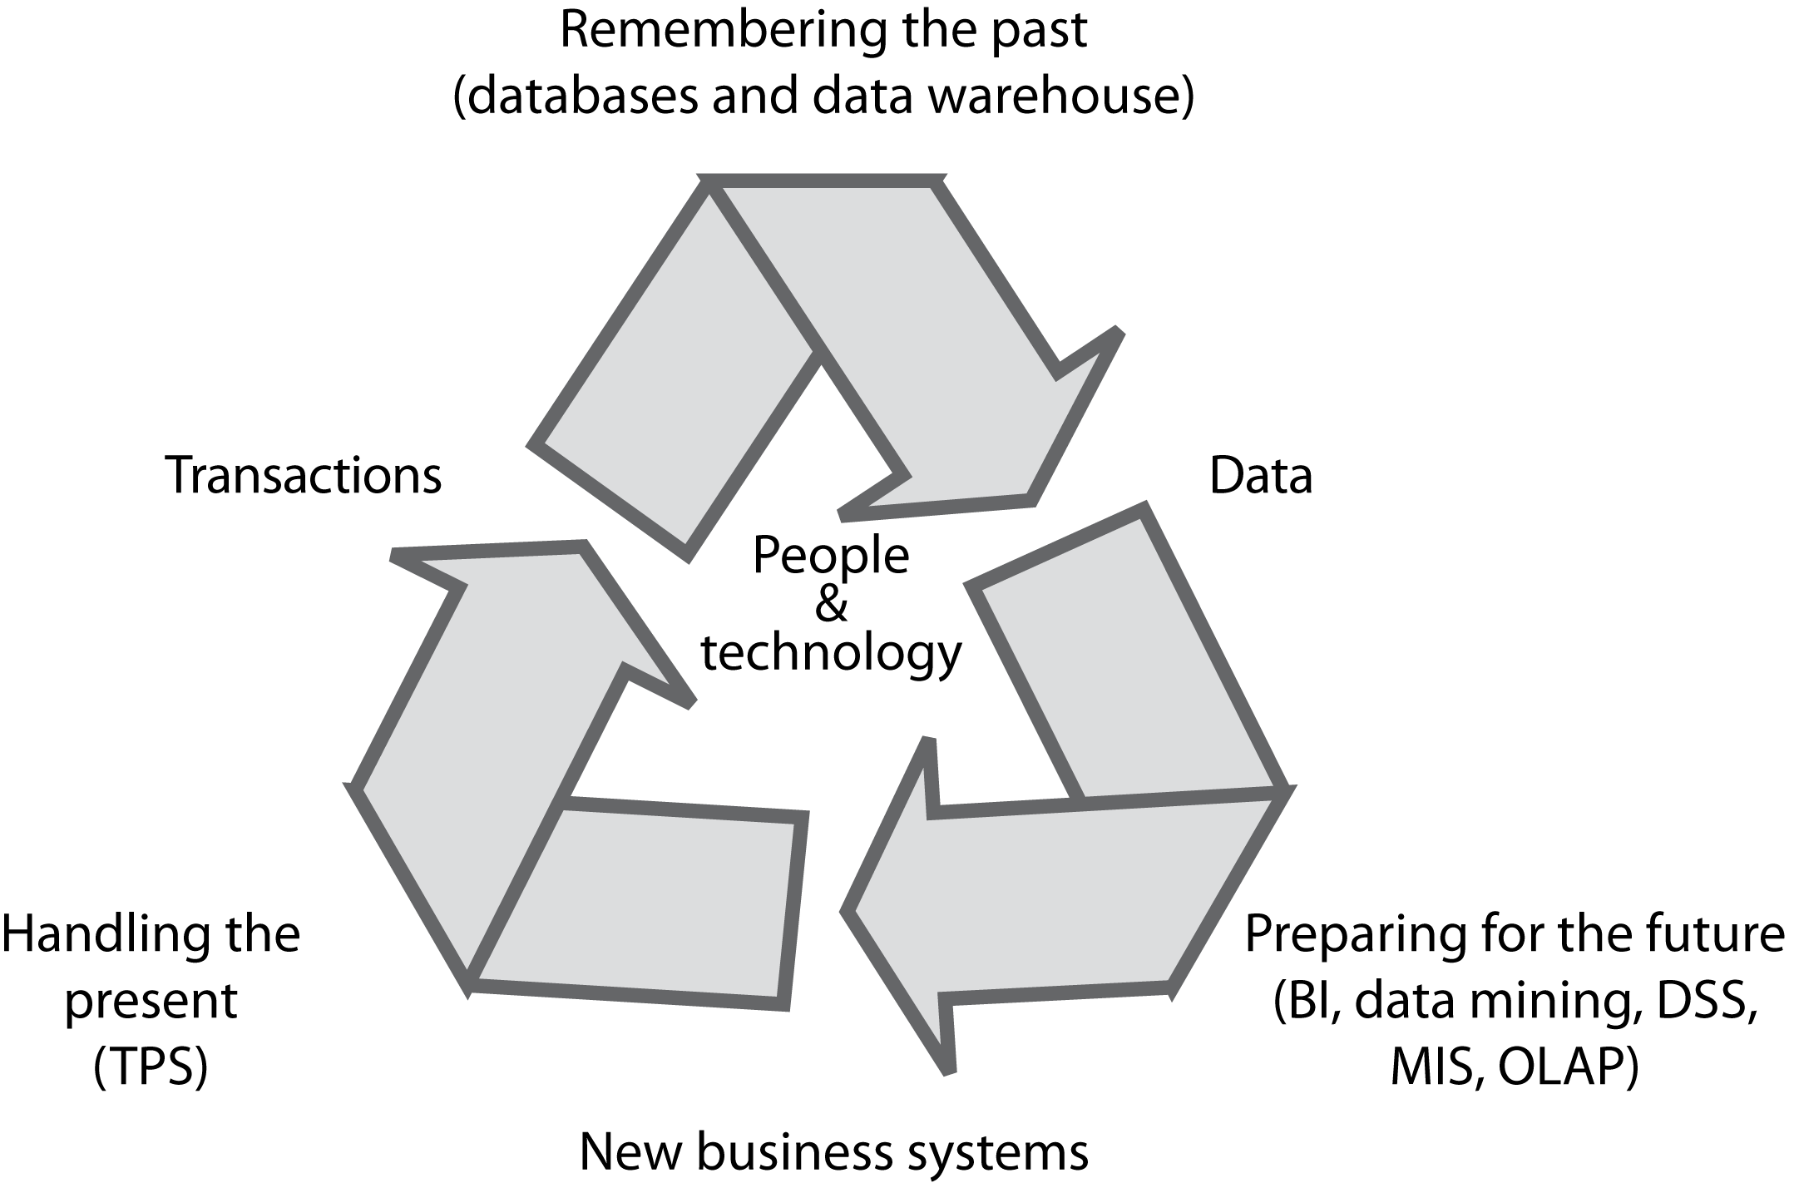
The information systems cycle

Slide 7
Transaction processing systems
Can generate huge volumes of data
A telephone company may generate several hundred million records per day
Raw material for organizational intelligence

Slide 8
The problem
Organizational memory is fragmented
Different systems
Different database technologies
Different locations
An underused intelligence system containing undetected key facts about customers
Alternate/related terms: Analytical databases, business intelligence systems, data warehouses, data marts, MDDB

Slide 9
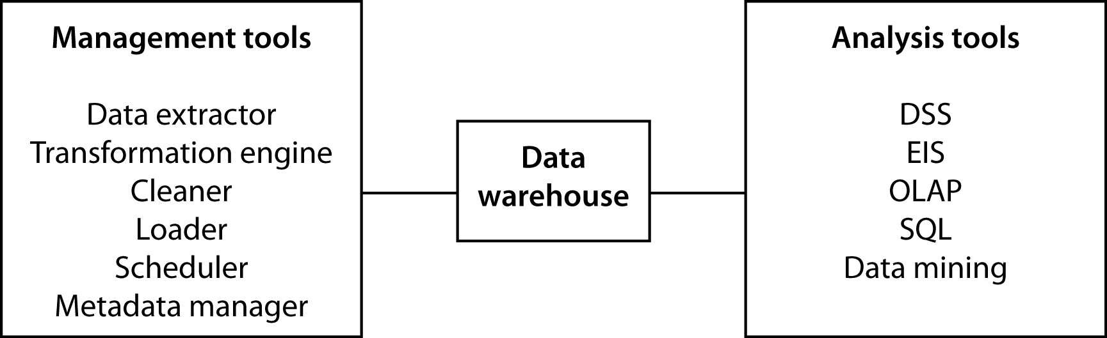
The data warehouse
A repository of organizational data
Can be measured in petabytes (10¹⁵)

Slide 10
Data warehouse -- Activities
Lesson 2
Extraction
Transformation
Cleaning
Loading
Scheduling
Metadata

Slide 11
Extraction
Pulling data from existing systems
Operational systems were not designed for extraction to load into a data warehouse
Applications are often independent entities
Time consuming and complex
An ongoing process

Slide 12
Transformation
Encoding
m/f, male/female to M/F
Unit of measure
inches to cms
Field
sales-date to salesdate
Date
dd/mm/yy to yyyy/mm/dd
Timezones

Slide 13
Cleaning
Same record stored in different departments
Multiple records for a company
Multiple entries for the same organization
Misuse of data entry fields

Slide 14
Scheduling
A trade-off
Too frequent is costly
Infrequently means old data

Slide 15
Metadata
A data dictionary containing additional facts about the data in the warehouse
Description of each data type
Format
Coding standards
Meaning
Operational system source
Transformations
Frequency of extracts

Slide 16
Warehouse architectures
Lesson 3
Centralized
Federated
Tiered

Slide 17
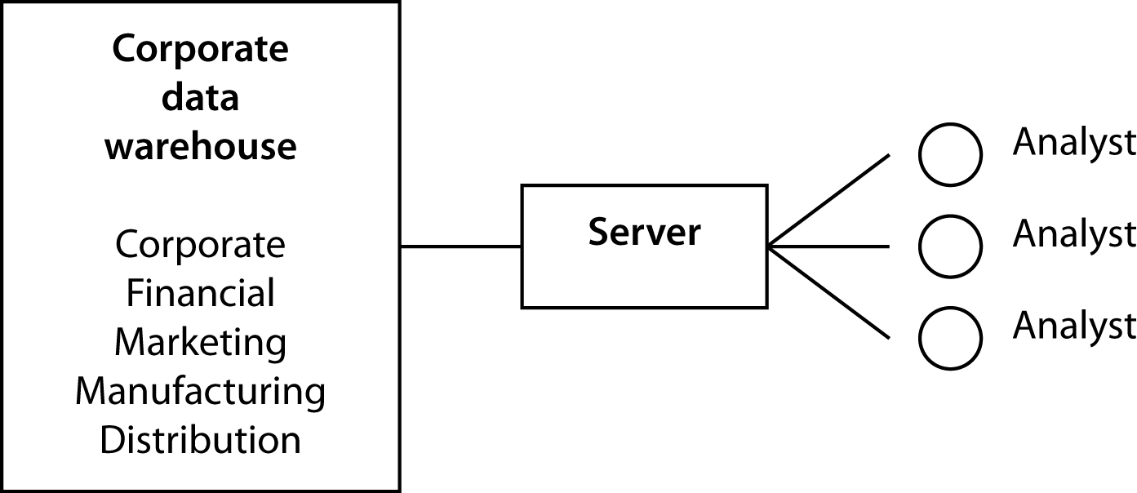
Centralized data warehouse

Slide 18
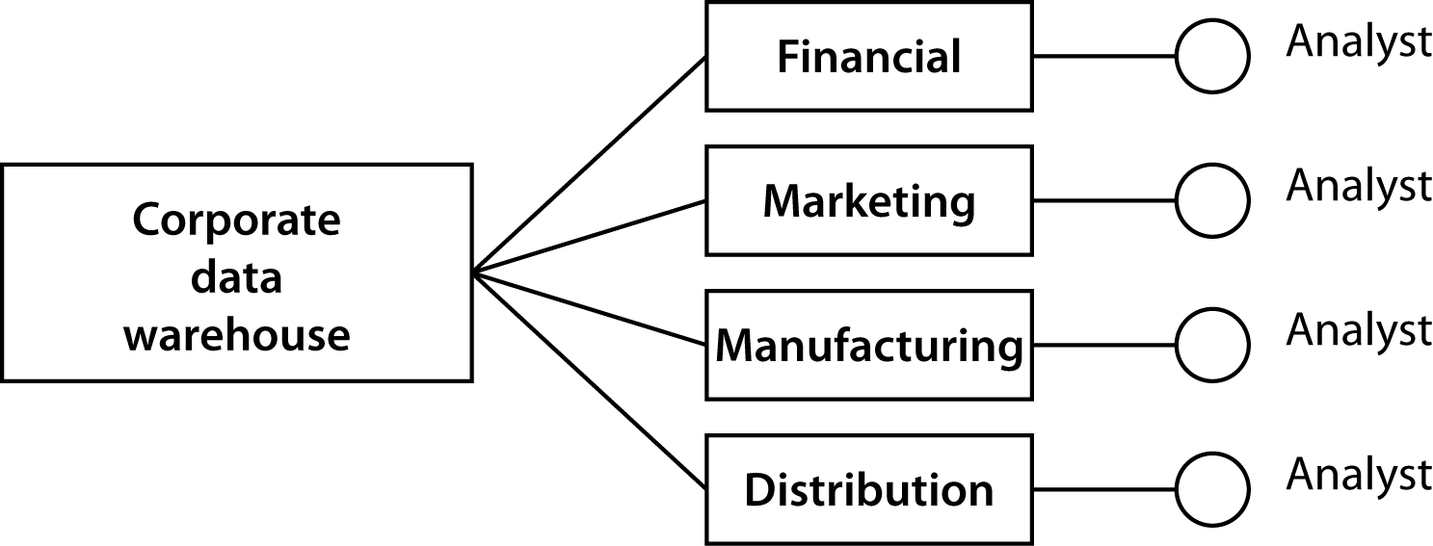
Federated data warehouse

Slide 19
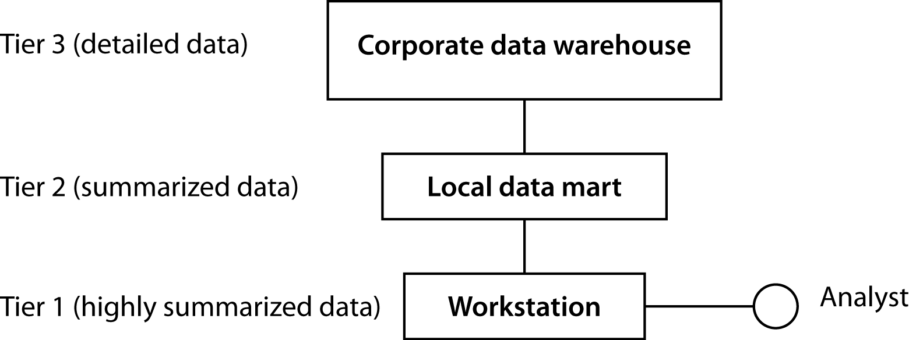
Tiered data warehouse

Slide 20
The server/software decision
Selection of a server architecture and DBMS are not independent decisions
Parallelism may be an option only for some RDBMSs
Need to find the fit that meets organizational goals
Hadoop is changing decision considerations rapidly

Slide 21
Exploiting data stores
OLAP implies a method of re-organizing the data in transactional systems in analytical databases.
Many OLAP tools available (created by computer sciency folks – emphasis is on speed and reliability of access)
Various data mining techniques help in verification and discovery
Many data mining tools available (created by statistics and visualization experts – emphasis is on prediction accuracy)
How you model an OLAP depends on what Verification and Discovery questions are asked.

Slide 22
Verification and discovery
Lesson 4
Verification | Discovery
What is the average sale for in-store and catalog customers? | What is the best predictor of sales?
What is the average high school GPA of students who graduate from college compared to those who do not? | What are the best predictors of college graduation?

Slide 23
Class Exercise 1
Problems 5&6

Slide 24
OLAP
Lesson 5
Relational model was not designed for data synthesis, analysis, and consolidation
This is the role of spreadsheets and other special purpose software
Need to complement RDBMS technology with a multidimensional view of data

Slide 25
TPS versus OLAP
TPS | OLAP
Optimize for transaction volume | Optimize for data analysis
Process a few records at a time | Process summarized data
Real time update as transactions occur | Batch update (e.g., daily)
Based on tables | Based on hypercubes
Raw data | Aggregated data
SQL is widely used | MDX becoming a standard

Slide 26
ROLAP
A relational OLAP
A multidimensional model is imposed on a relational structure
Relational is a mature technology with extensive data management features
Not as efficient as OLAP

Slide 27
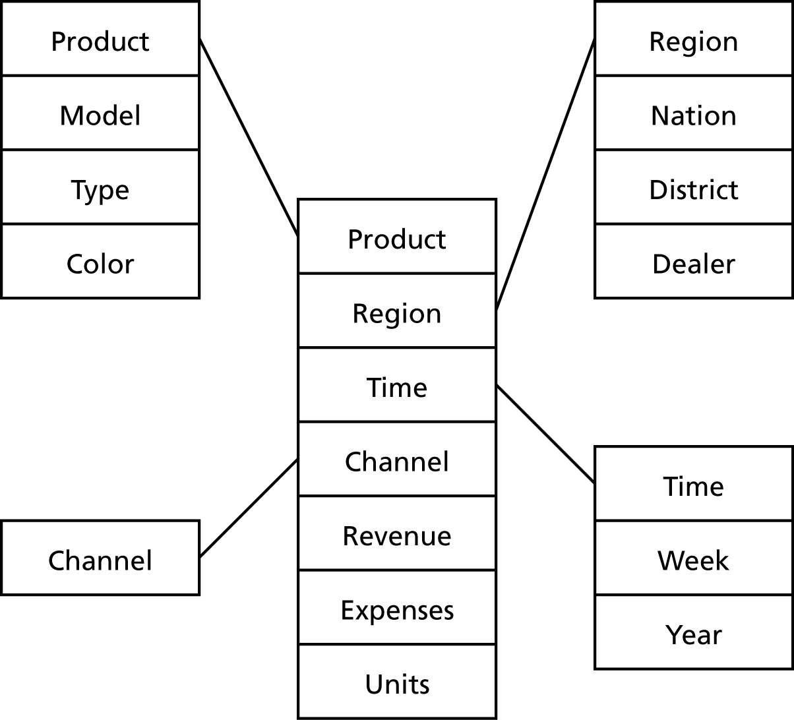
Modelling “Analytical” Databases - The star structure
Lesson 6
A central fact table is connected to multiple dimensional tables
A single join can relate the fact table with any one of the dimensional tables

Slide 28
Analytics using DWs
Variable and facts are ideally continuous
Dimensions can ideally be continuous but also nominal or ordinal.
More powerful analysis when dimensions are continuous
But space requirements enlarge significantly
Analytic techniques (e.g., forecasting, prediction, segmentation) depend on the type of data available

Slide 29
Watch Video
Video

Slide 30
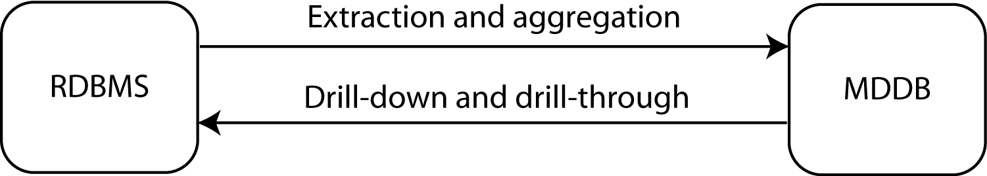
The link between RDBMS and MDDB
Lesson 9

Slide 31
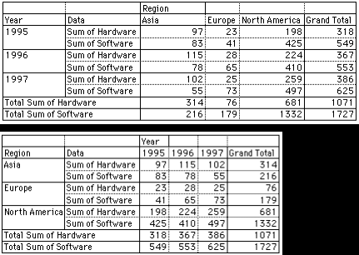
Rotation

Slide 32
Drill down
Region | Sales variance
Africa | 105%
Asia | 57%
Europe | 122%
North America | 97%
Pacific | 85%
South America | 163%
Nation | Sales variance
China | 123%
Japan | 52%
India | 87%
Singapore | 95%

Slide 33
A hypercube

Slide 34
A three-dimensional hypercube display
Page |  |  |  |  | Columns
Region: North |  |  |  |  | Sales
 |  |  | Red blob | Blue blob | Total
 |  | 1996
Rows |  | 1997
Year |  | Total

Slide 35
A six-dimensional hypercube
Dimension | Example
Brand | Mt. Airy
Store | Atlanta
Customer segment | Business
Product group | Desks
Period | January
Variable | Units sold

Slide 36
A six-dimensional hypercube display
Page |  |  |  |  |  |  | Columns
Month Segment |  |  |  |  |  |  | Product group Variable
 |  | March | Business | Desks |  | Chairs
 |  |  |  | Units | Revenue | Units | Revenue
 |  | Carolina | Atlanta
 |  |  | Boston
Rows |  | Mt. Airy | Atlanta
Brand |  |  | Boston
Store |  | Totals

Slide 37
MDDB design
Key concepts
Variable dimensions
What is tracked
Sales
Identifier dimensions
Tagging what is tracked
Time, product, and store of sale

Slide 38
Prompts for identifying dimensions
Prompt | Example
When? | June 5, 2013 10:27am
Where? | Paris
What? | Tent
How? | Catalog
Who? | Young adult woman
Why? | Camping trip to Bolivia
Outcome? | Revenue of €624.00
Transaction data
Face recognition or credit card co.
Social media
Transaction data

Slide 39
Variables and identifiers
Identifier time (hour) | Variable sales (dollars)
10:00 | 523
11:00 | 789
12:00 | 1,256
13:00 | 4,128
14:00 | 2,634
Identifier hit | Variable time (hh:mm:ss)
1 | 9:34:45
2 | 9:34:57
3 | 9:36:12
4 | 9:41:56

Slide 40
Class Exercise 2
Identify the de-normalized attributes in the star schema on the previous slide.
Problems 8 & 9

Slide 41
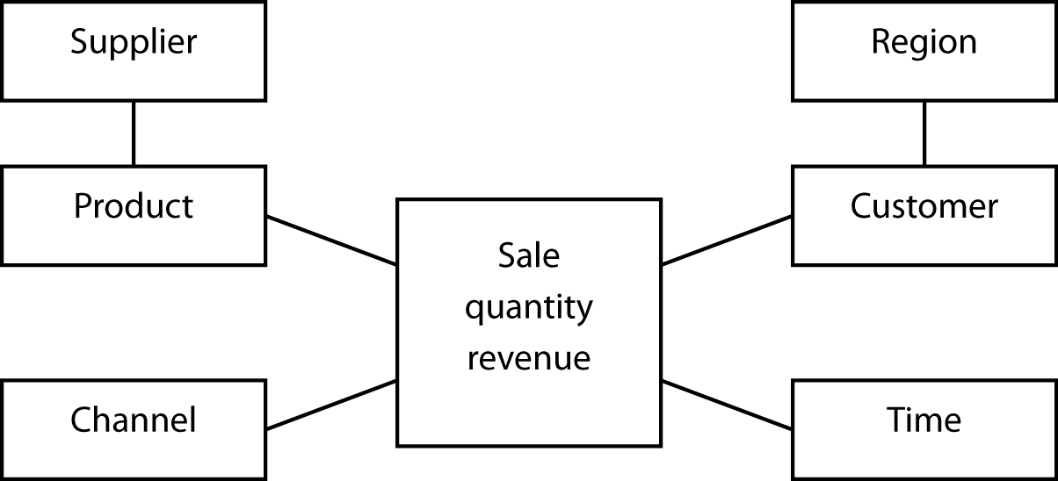
The snowflake structure
Lesson 7
An extension of the star schema to handle very large dimensional tables
Multiple joins might be required to fetch data.
Difference between Star and Snowflake: degree of normalization, space requirements

Slide 42
Exercise
Refer to Employees DB:
Identify a star for a data-warehouse and then its snowflake version.
An international hotel chain has asked you to design a multidimensional database for its marketing department. What identifiers (dimensions) and variables (fact) would you select?

Slide 43
SQL-99 and OLAP
Lesson 8
SQL can be tedious and inefficient
The following questions require four queries
Find the total revenue
Report revenue by location
Report revenue by channel
Report revenue by location and channel

Slide 44
(cont’d)
GROUP BY extended with
GROUPING SETS
ROLLUP
CUBE
MySQL supports only ROLLUP and in a slightly different format

Slide 45
GROUPING SETS
SELECT location, channel, SUM(revenue)
FROM exped
GROUP BY GROUPING SETS (location, channel);
Location | Channel | Revenue
null | Catalog | 108762
null | Store | 347537
null | Web | 27166
London | null | 214334
New York | null | 39123
Paris | null | 143303
Sydney | null | 29989
Tokyo | null | 56716

Slide 46
ROLLUP
Location | Channel | Revenue
null | null | 483465
London | null | 214334
New York | null | 39123
Paris | null | 143303
Sydney | null | 29989
Tokyo | null | 56716
London | Catalog | 50310
London | Store | 151015
London | Web | 13009
New York | Catalog | 8712
New York | Store | 28060
New York | Web | 2351
Paris | Catalog | 32166
Paris | Store | 104083
Paris | Web | 7054
Sydney | Catalog | 5471
Sydney | Store | 21769
Sydney | Web | 2749
Tokyo | Catalog | 12103
Tokyo | Store | 42610
Tokyo | Web | 2003
SELECT location, channel, SUM(revenue)
FROM exped
GROUP BY ROLLUP (location, channel);

Slide 47
CUBE
Location | Channel | Revenue
null | Catalog | 108762
null | Store | 347537
null | Web | 27166
null | null | 483465
London | null | 214334
New York | null | 39123
Paris | null | 143303
Sydney | null | 29989
Tokyo | null | 56716
London | Catalog | 50310
London | Store | 151015
London | Web | 13009
New York | Catalog | 8712
New York | Store | 28060
New York | Web | 2351
Paris | Catalog | 32166
Paris | Store | 104083
Paris | Web | 7054
Sydney | Catalog | 5471
Sydney | Store | 21769
Sydney | Web | 2749
Tokyo | Catalog | 12103
Tokyo | Store | 42610
Tokyo | Web | 2003
SELECT location, channel, SUM(revenue)
FROM exped
GROUP BY CUBE (location, channel);

Slide 48
MySQL version of ROLLUP
SELECT location, FORMAT(SUM(revenue),0)
FROM exped
GROUP BY location WITH ROLLUP;
SELECT location, channel, FORMAT(SUM(revenue),0)
FROM exped
GROUP BY location, channel WITH ROLLUP;

Slide 49
Exercises
Using ClassicModels
Compute total payments by country without and with ROLLUP
Compute total payments by country and year without and with ROLLUP
Compute total value of orders by country, and product line without and with ROLLUP

Slide 50
Data mining
Lesson 9
The search for relationships and patterns
Applications
Database marketing
Predicting bad loans
Detecting flaws in VLSI chips
Identifying quasars

Slide 51
Data mining functions
Depend on the type of data available
Associations
85 percent of customers who buy a certain brand of wine also buy a certain type of pasta
Sequential patterns
32 percent of female customers who order a red jacket within six months buy a gray skirt
Classifying
Frequent customers as those with incomes about $50,000 and having two or more children
Clustering
Market segmentation
Predicting
Predict the revenue value of a new customer based on that person’s demographic variables

Slide 52
Data mining technologies
Decision trees
Genetic algorithms
K-nearest-neighbor method
Neural networks
Data visualization

Slide 53
Conclusion
Data management is an evolving discipline
Data managers have a dual responsibility
Manage data to be in business today
Manage data to be in business tomorrow
Data managers now need to support organizational intelligence technologies

Slide 54
Next Week
Quiz
Article by Hasan & Hyland (2001)
Create a student user id on TUN website
Browse student competition info on TUN

